Slide 1
Yr11 Revision Lesson
Topic: Statistics
EQ: What do I need to know for the test?

Slide 2
Types of Data
Catergorical: data that can be sorted into categories (favourite shoe brand, types of cars etc)
Numerical: data that is measured in numbers. Two types of numerical data; Discrete and Continuous.
Discrete: data that take on specific values (shoe size, amount of burgers eaten etc)
Continuous: Data that is measured (length of your shoe, time taken etc)

Slide 3
Types of data questions
State what type of data the following are:
Favourite animal
Heights of buildings
Colours of cars
Number of cars
Categorical
Numerical Continuous
Categorical
Discrete numerical

Slide 4
Measures of average
Mean: sum of all scores divided by the number of scores
Median: The middle number in a data set (put numbers in order and find the middle, if two numbers are in the middle add together and divide by 2)
Mode: The most common score, you can have 2 modes (bimodal) or one mode (unimodal)

Slide 5

Find the mean, median and mode for the following data set
12, 34, 15, 19, 21, 9, 14, 15
9, 12, 14, 15, 15, 19, 21, 34
Mean: $\frac{9+12+14+15+15+19+21+34}{8} =17.375$
Median: 9, 12, 14, 15, 15, 19, 21, 34; 2 in the middle $\frac{15+15}{2}=15$
Mode: most common is 15

Slide 6
5 number summaries
5 number summary: lowest score, lower quartile (Q1), median (Q2), Upper quartile (Q3), and largest score.
Step 1, put the scores in ascending order
Step 2, find the lowest and highest
Step 3, find the median
Step 4, find the lower and upper quartiles (middle of the bottom half and middle of the top half)

Slide 7
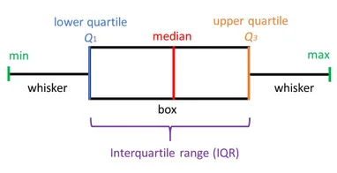
Box and whisker plots

Slide 8
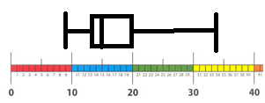
Find the 5 number summary and draw the box and whisker plot for the following
12, 34, 15, 19, 21, 9, 14, 15
9, 12, 14, 15, 15, 19, 21, 34
Low: 9, Q1: 13, Med: 15, Q3:20, Max:34

Slide 9
Measures of spread
Range: Highest score take the lowest score
IQR: upper quartile take lower quartile
Standard Deviation: the average distance from the mean. (you don’t need to know how to calculate, but you need to know what it shows.
Basically the bigger your measure of spread is, the more spread out/ less consistent your data is.

Slide 10
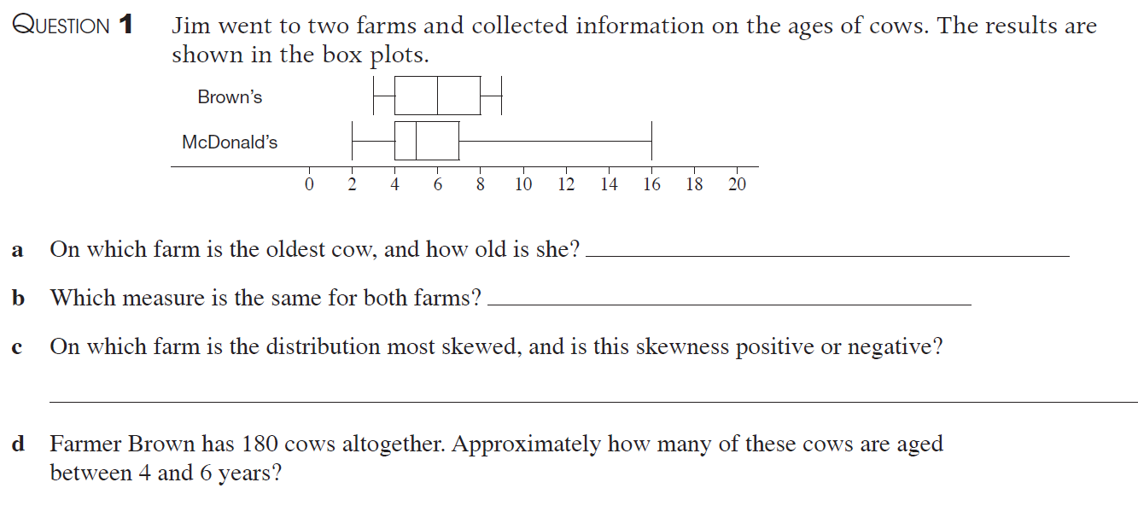
Answer the following
e Which of the farms do you think has the larger standard deviation? Explain your answer using the other measures of spread

Slide 11
Answer the following
Mcdonalds, 16 years old
Lower quartile
Mcdonalds, positive skew
25% of 180= 45 cows
Mcdonalds, the graph is more spread out and has a bigger range
e Which of the farms do you think has the larger standard deviation? Explain your answer using the other measures of spread

Slide 12
Outliers!
An outlier is a piece of data that is really small or really big and doesn’t fit with the rest of the data.
12, 34, 15, 19, 21, 9, 14, 15
Outlier is 35 .
Calculate the mean and median with and without the outlier and comment on the effect.
With the outlier | Outlier removed | effect
Mean: 17.375 | Mean:15
Median: 15 | Median: 15

Slide 13
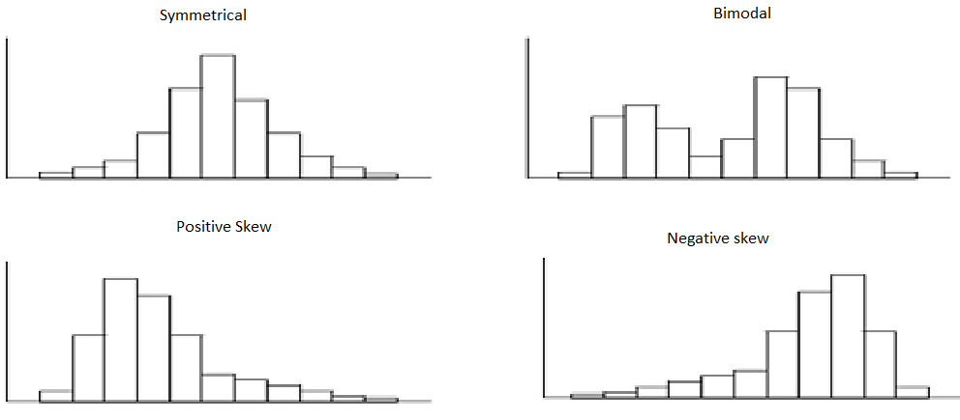
Shape of data
Shape of data can be described using symmetrical, positive skew, negative skew or bimodal. Bimodal has 2 peaks, 1 peak is unimodal.

Slide 14
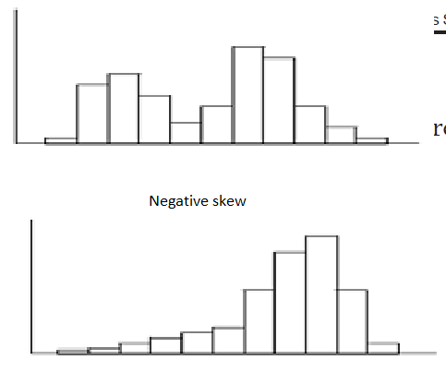
Describe the shape of the following
Bimodal
Positive skew

